Slide 1

Economics Project -4
FDI and India : The Developments

Slide 2
Group -3 Members
Aneri Sheth - 1401072
Hemil Gurjar - 1401002
Himanshu Budhia - 1401039
Janki Desai - 1401103
Kunal Suba - 1401097
Palash Hariyani - 1401101
Rajvi Prajapati - 1401033
Rupande Shastri - 1401102

Slide 3
Table of Contents
What is Foreign Direct Investment (FDI)?
History of FDI – Emergence and Outcomes of Post Reforms
FDI – Determinants, Types, Methods and Ways
Sources of FDI in India – Wal-Mart as an example
Government Initiatives and their developments –Make in India
FDI Reforms in India – Sector-specific reforms, their impact and challenges(2014)
Make in India and FDI Sector-specific reforms of 2015
FDI Development in various sectors – Statistics and Challenges
FDI of India vs. Other countries
Conclusion

Slide 4
Foreign Direct Investment
A foreign direct investment (FDI) is a controlling ownership in a business enterprise in one country by an entity based in another country
Foreign direct investment is distinguished from portfolio foreign investment, a passive investment in the securities of another country such as public stocks and bonds, by the element of "control“
According to the Financial Times, "Standard definitions of control use the internationally agreed 10 percent threshold of voting shares, but this is a grey area as often a smaller block of shares will give control in widely held companies.”

Slide 5
History of FDI in India
Major of the FDI came from the East India Company in the 18th Century
After Independence in 1947, India adhered to socialist policies
Though attempts were made to liberalize economy in 1966 and 1985, a major attempt to liberalize economy was in 1985 by PM Rajiv Gandhi
The government had to make economic reforms in 1991, after India faced a balance of payment crisis following the Gulf War and the downfall of Soviet Union

Slide 6
Emergence of FDI in India
India had to pledge 20 tons of gold to Union Bank of Switzerland and 47 tons to Bank of England as part of bailout deal with the IMF(International Monetary Fund)
The IMF required India to undertake a series of structural economic reforms
As a result the government of P.V. Narasimha Rao and his finance minister Manmohan Singh started breakthrough reforms, although they did not implement many of the reforms IMF wanted
The new neo-liberal policies included opening for international trade and investment, deregulation, initiation of privatization, tax reforms, and inflation-controlling measures.

Slide 7
Outcomes of Past Reforms
Overall amount of overseas investment rose to $5.3 billion in 1995-1996 in the country from a microscopic US $132 million in 1991-1992
India in 1997 allowed foreign direct investment (FDI) in cash and carry wholesale
Then, it required government approval. The approval requirement was relaxed, and automatic permission was granted in 2006
Between 2000 to 2010, Indian retail attracted about $1.8 billion in foreign direct investment, representing a very small 1.5% of total investment flow into India

Slide 8
Determinants of Foreign Direct Investment
Firm-specific advantages: Once domestic investment was exhausted, a firm could exploit its advantages linked to market imperfections, which could provide the firm with market power and competitive advantage
Removal of conflicts: Conflict arises if a firm is already operating in foreign market or looking to expand its operations within the same market. However, it must be taken into account that a reduction in conflict through acquisition of control of operations will increase the market imperfections
Propensity to formulate an internationalization strategy to mitigate risk: According to the position, firms are characterized with 3 levels of decision making: the day to day supervision, management decision coordination and long term strategy planning and decision making. The extent to which a company can mitigate risk depends on how well a firm can formulate an internationalization strategy taking these levels of decision into account.

Slide 9
Types of Foreign Direct Investment
Horizontal FDI arises when a firm duplicates its home country-based activities at the same value chain stage in a host country through FDI
Platform FDI- Foreign direct investment from a source country into a destination country for the purpose of exporting to a third country
Vertical FDI takes place when a firm through FDI moves upstream or downstream in different value chains i.e., when firms perform value-adding activities stage by stage in a vertical fashion in a host country

Slide 10
Methods of Foreign Direct Investment
The investor may acquire voting power of an enterprise in an economy through any of the methods:
By incorporating a wholly owned subsidiary or company anywhere
By acquiring shares in an associated enterprise
Through a merger or an acquisition of an unrelated enterprise
Participating in an equity joint venture with another investor or enterprise

Slide 11
Ways of FDI
Automatic Route : Most sectors are now open to 100% FDI, meaning thereby, that the foreign companies do not need a prior approval for investment either by the Government or the Reserve Bank of India. It allows the Indian companies engaged in various industries to issue shares to foreign investors up to 100% of their paid up capital in Indian companies.
Approval Route: There are certain activities that are not covered under the automatic route and that require prior Government approval and are considered by the Foreign Investment Promotion Board (FIPB).

Slide 12
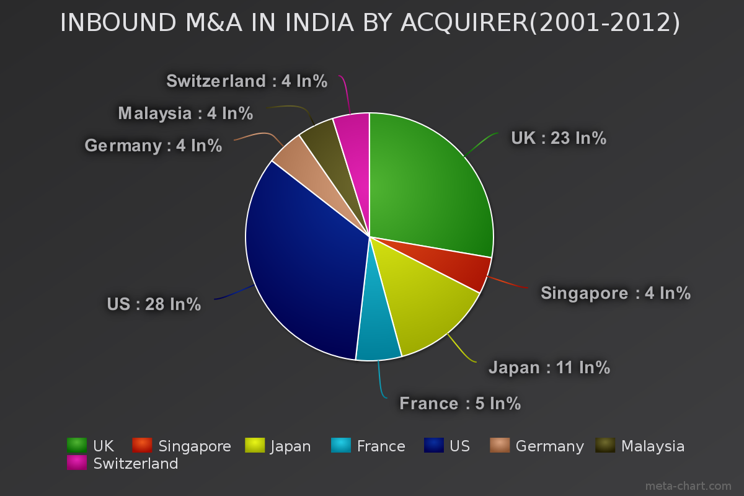
Sources of FDI Flow

Slide 13
Sources of FDI Flow (Cont.)
India attracted USD 9.03 billion in FDI from Mauritius in 2014-15, whereas it was USD 6.74 billion from Singapore
Other nations from where foreign inflows are increasing include Japan, the Netherlands, the US, Germany, France and the UAE during the last financial year.

Slide 14

Wal-Mart India

Slide 15
Wal-Mart India Private Limited is a wholly owned subsidiary of Wal-Mart Stores Inc. Wal-Mart India owns and operates 20 Best Price Modern Wholesale stores in 8 states across India. The first store opened in Amritsar in 2009
Wal-Mart is now seeking to open its own retail chain throughout India
India’s $250 billion retail business is the eighth largest in the world and has the potential to grow 7 per cent by 2011
For a company already dominating the world markets, this is an un-passable opportunity
The owners of Wal-Mart stand to gain enormous profits from this move while India’s economy will suffer and its workers will be subjugated to the unfair work practices.

Slide 16
Government Initiatives
The Government of India has amended FDI policy to increase FDI inflow
The Government of India recently relaxed the FDI policy norms for Non-Resident Indians (NRIs). Under this, the non-repatriable investments made by the Persons of Indian Origin (PIOs), Overseas Citizens of India (OCI) and NRIs will be treated as domestic investments and will not be subject to FDI caps
The government has also raised FDI cap in insurance from 26 per cent to 49 per cent through a notification issued by the DIPP. The limit is composite in nature as it includes foreign investment in the form of foreign portfolio investment, foreign institutional investment, qualified foreign investment, foreign venture capital investment, and non-resident investment

Slide 17
The Cabinet Committee on Economic Affairs (CCEA) has raised the threshold for foreign direct investment requiring its approval to Rs 3,000 crore (US$ 469 million) from the present Rs 1,200 crore (US$ 187 million). This decision is expected to expedite the approval process and result in increased foreign investment inflow
India’s cabinet cleared a proposal which allows 100 per cent FDI in railway infrastructure, excluding operations. Though the initiative does not allow foreign firms to operate trains, it allows them to invest in areas such as creating the network and supplying trains for bullet trains etc.

Slide 18
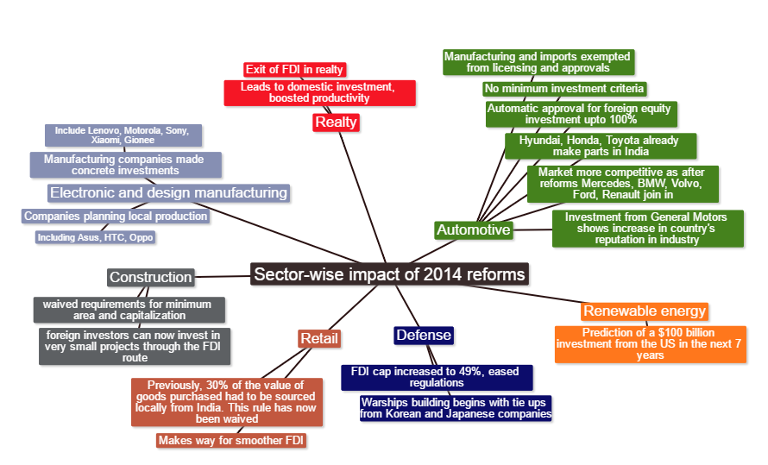

Slide 19
Impact of FDI reforms in 2014
After relaxing FDI norms and introducing the Make In India campaign in 2014, the Prime Minister of India made trips to 18 countries to promote the economic propaganda and to invite foreign investments
This generated a wave of interest among the investors, as India has two major things to offer: Low cost labor and a risk taking economic environment
The reforms caused an overall increase in the FDI inflow in the following year. However, the effects varied in different sectors of the economy

Slide 21
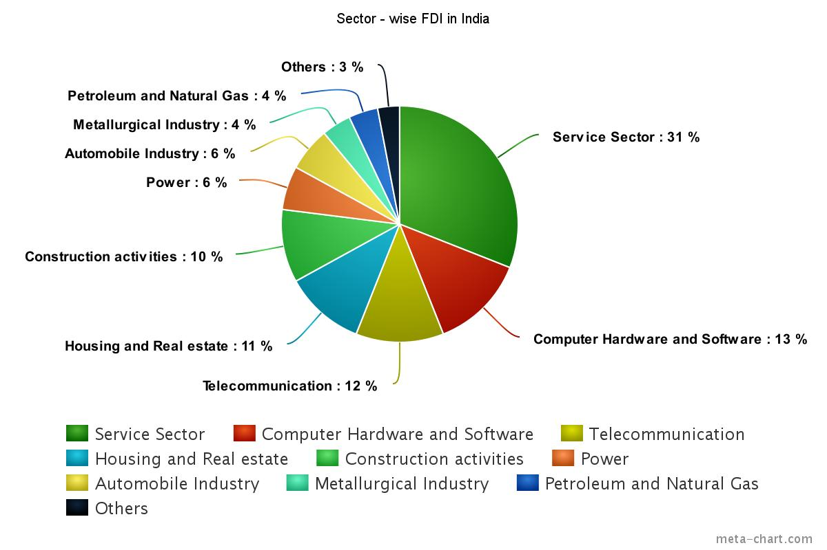

Slide 22
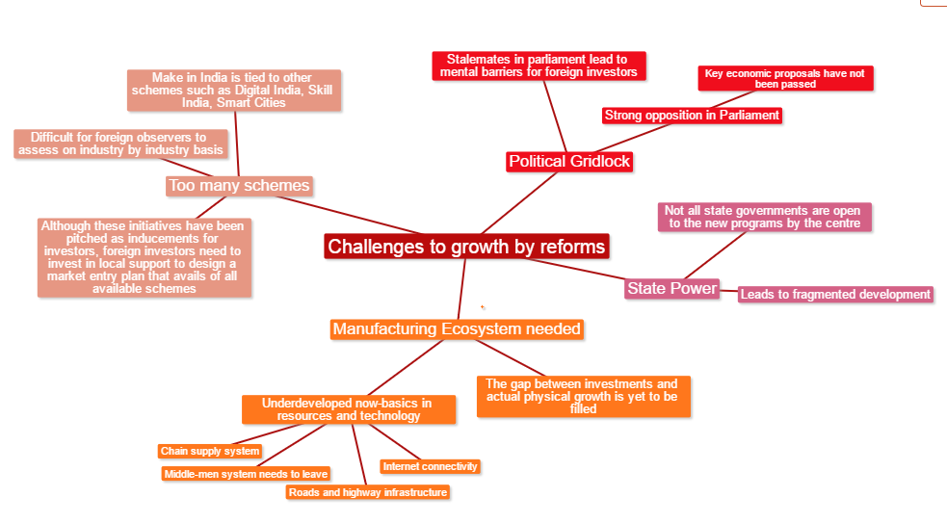

Slide 23
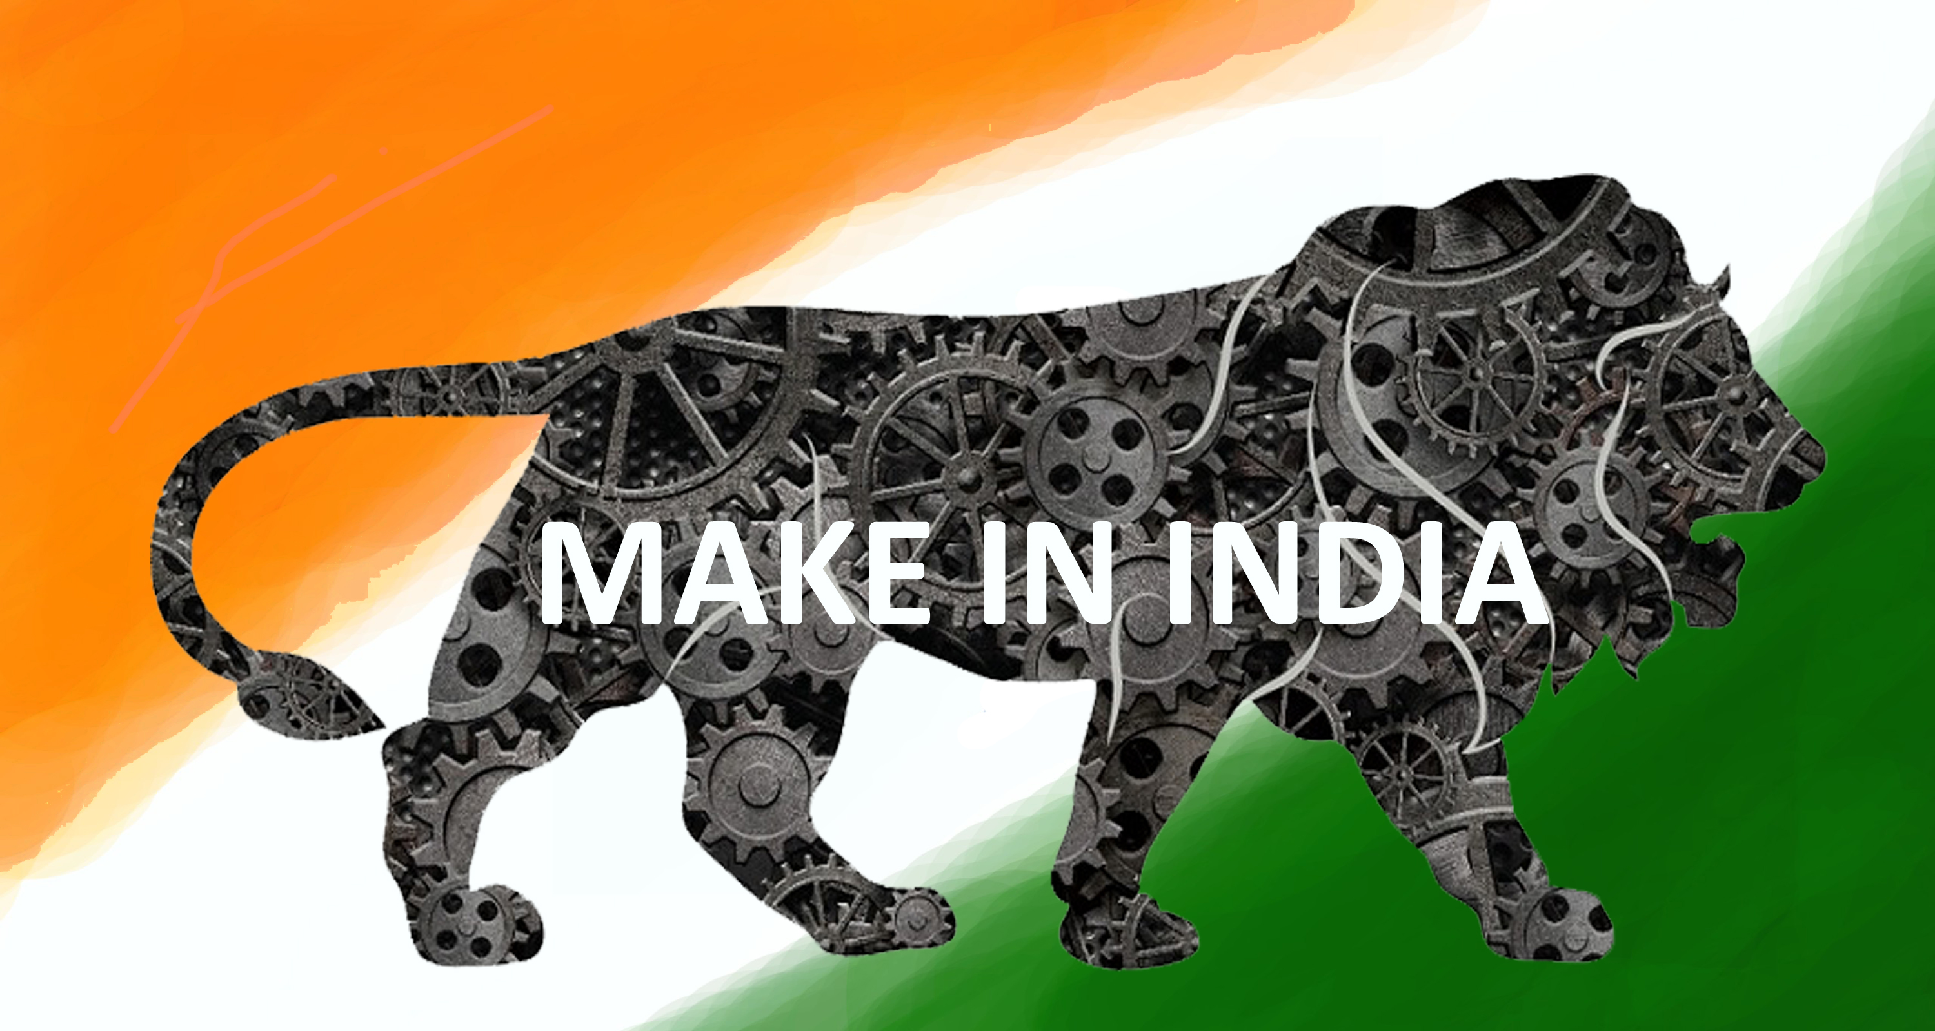
Make in India

Slide 24
In 2014, the government increased foreign investment upper limit from 26% to 49% in insurance sector. It also launched Make in India initiative in September 2014 under which FDI policy for 25 sectors was liberalized further
As of April 2015, FDI inflow in India increased by 48% since the launch of "Make in India" initiative
The Make in India program was launched by PM Narendra Modi in September 2014 as part of a wider set of nation-building initiatives in response to critical economic crisis
India has already marked its presence as one of the fastest growing economies of the world. It has been ranked among the top 3 attractive destinations for inbound investments. Since 1991, the regulatory environment in terms of foreign investment has been consistently eased to make it investor-friendly

Slide 25
FDI Reforms in India
With the view to promote 'Make in India' and 'Startup India' initiatives, the Government published a Press Note on November 10, 2015 outlining significant reforms in the Foreign Direct Investment Policy
To bring in foreign investments in the country, the Modi Government has brought in FDI related reforms and liberalisation touching upon 15 major Sectors of the Economy
The reforms are aimed at attracting more foreign investments through further easing, rationalising and simplifying the process of foreign investments in the country and putting more FDI proposals under the automatic route

Slide 26
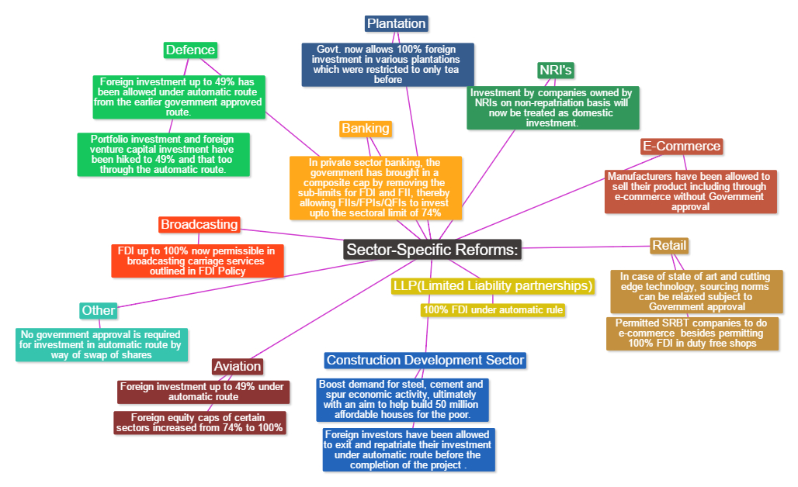

Slide 27
Developments considering FDI India
Based on the recommendations of Foreign Investment Promotion Board (FIPB), the Government, in a meeting held on September 29, 2015, approved 18 proposals of FDI amounting to approximately Rs 5,000 crore (US$ 770 million)
Japan has won the right to construct India’s first bullet train, while offering a loan of US$ 8.11 billion to India for the same
Chinese mobile handset maker, Coolpad Group Limited, has committed US$ 300 million for setting up a research and development (R&D) centre and its own assembly line in India by 2017

Slide 28
Amazon India expanded its logistics footprint three times to more than 2,100 cities and towns in 2015, as Amazon.com invested more than US$ 700 million in its India operations since July 2014
Indian Railways has issued a Letter of Award (LoA) to US-based General Electric (GE) for a Rs 14,656 crore (US$ 2.2 billion) diesel locomotive factory project at Marhowra, and to French transport major Alstom for Rs 20,000 crore (US$ 3 billion) electric locomotive project in Madhepura, Bihar
Kellogg Co, world's largest cereal maker, is making large investments in manufacturing and plans to set up its first Research and Development (R&D) facility in India at Taloja, near Mumbai

Slide 29
FDI in India vs. Other countries
The Indian government’s favourable policy regime and robust business environment have ensured that foreign capital keeps flowing into the country and hence foreign investors usually prefer some countries over others at a given time
Foreign companies invest directly in fast growing private Indian businesses to take benefits of cheaper wages and changing business environment of India

Slide 30
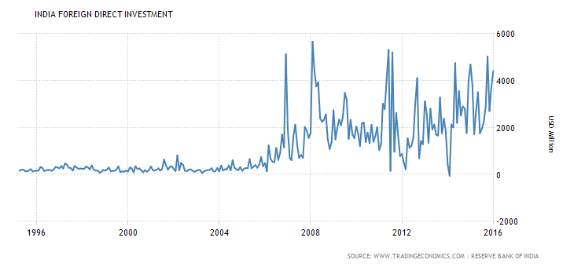
Graph showing FDI in India over the past 20 years

Slide 31
Analysis of India’s FDI
Foreign Direct Investment in India is reported by the Reserve Bank of India
Foreign Direct Investment in India increased by 4413 USD Million in January of 2016
Foreign Direct Investment in India averaged 1140.51 USD Million from 1995 until 2016, reaching an all-time high of 5670 USD Million in February of 2008 and a record low of -60 USD Million in February of 2014

Slide 32
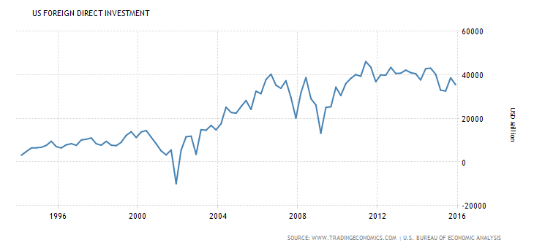
Graph showing FDI in USA over the past 20 years

Slide 33
Analysis of USA’s FDI
Foreign Direct Investment in the United States refers to income position without current-cost adjustment
Foreign Direct Investment in the United States is reported by the U.S. Bureau of Economic Analysis
Foreign Direct Investment in the United States increased by 35494 USD Million in the fourth quarter of 2015
Foreign Direct Investment in the United States averaged 22464.57 USD Million from 1994 until 2015, reaching an all-time high of 46165 USD Million in the second quarter of 2011 and a record low of -9988 USD Million in the fourth quarter of 2001.

Slide 34
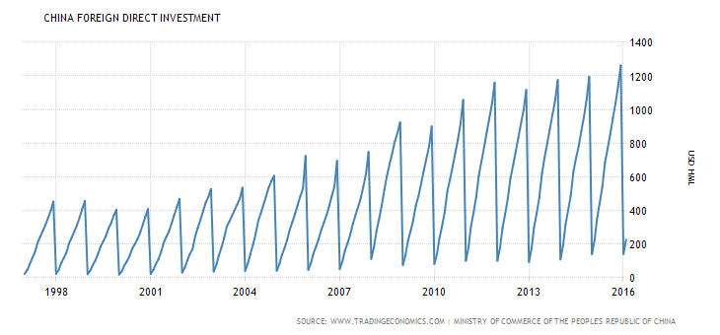
Graph showing FDI in China over the past 20 years

Slide 35
Analysis of China’s FDI
In China, foreign direct investment refers to the accumulated foreign investment in domestic companies or entities in non -financial sector in a given year
Foreign Direct Investment in China is reported by the Ministry of Commerce of the People's Republic of China
Foreign Direct Investment in China increased 4.5 percent year-on-year in the first three months of 2016. Foreign Direct Investment in China averaged 416.01 USD HML(High minus Low) from 1997 until 2016, reaching an all -time high of 1262.70 USD HML in December of 2015 and a record low of 18.32 USD HML in January of 2000

Slide 36
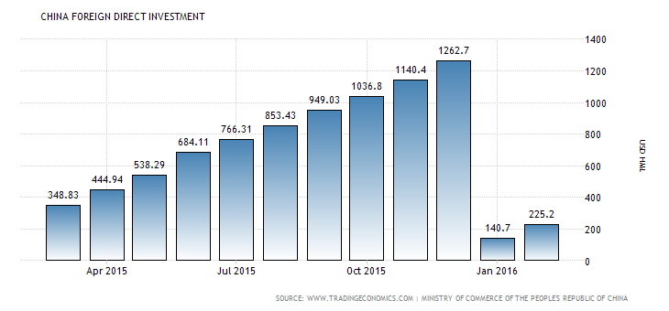
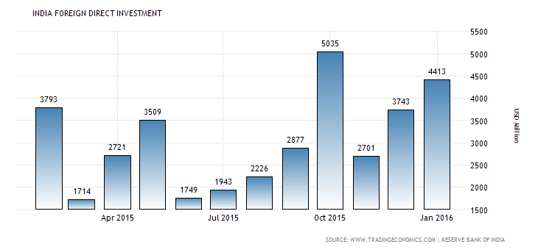
Since China is a tough competitor of India, it is important to understand trends in the FDI over the past 5 years

Slide 37
India’s Position in the World Market of FDI
Since India is a developing country with world’s second largest population after China, it is significant to know where India stands in terms of Economy – Growth and Development
FDI has two aspects – Inflows (where countries invest in India) and Outflows(where we invest in other countries)
On the basis of these two aspects, India stands 9th (2014) in inflows FDI and it emerges as top one of the top 10 FDI destination
India is not among top 20 countries in outflows FDI which is a major concern in Indian Economy

Slide 38
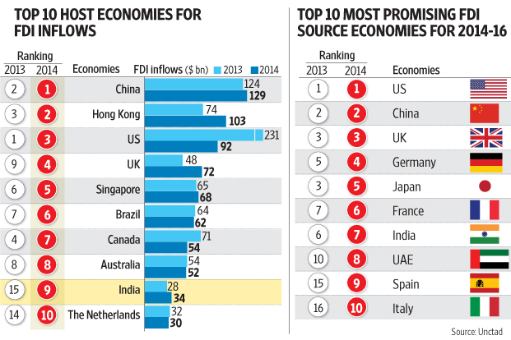

Slide 39
The Financial Times of London Controversy
A recent report by a data consultancy owned by the Financial Times of London created a stir by estimating that India is now the most favourite destination for foreign direct investment, beating China and the USA. The fine print indicates that they are talking about "estimated capital expenditures" in new ventures. By this estimate, India attracted $31 billion compared to China's $28 billion in the first half of 2015
Reserve Bank of India (RBI) data for foreign investment flows does not appear to reflect this, causing much puzzlement in India. The total foreign direct investment that flowed into India between January and June 2015 is pegged at $20.6 billion. If you deduct the outflow from India in the form of outgoing FDI from India, this gets pared down to $19 billion

Slide 40
Besides this inflow, there is also foreign portfolio investment mainly by institutional investors in the stock market. This was about $17 billion in the first half of 2015
Putting these two components of investment - direct and portfolio - together yields about $31.5 billion for the same period. But this could hardly be what the FT report is talking about since much of this is neither greenfield nor capital investment
A comparison of RBI data between the first halves of 2014 and 2015 shows that incoming FDI has increased by about 16% in 2015 but outgoing FDI has drastically declined, probably due to weakening economies around the world. Hence net FDI inflow to India has jumped up from $8.8 billion to $19 billion.

Slide 41
Lag of India FDI in terms of China and USA
Over the last decade India has emerged as one of the favourite destination for foreign investors
But compared to China and USA, India still lags behind in attracting foreign investment
Some of the main factors which tend to act as roadblock for foreign investment in India include:
Political considerations
Poor infrastructure
Inadequate government policies
Rigid labour laws
Rampant corruption.

Slide 42
Crucial Period: 2013-2017 and so on
India was ranked ninth in 2014 while it was 15th in 2013
During 2014, FDI inflows into India jumped 22% to $34 billion at a time when global FDI fell by 16% to $1.23 trillion. UNCTAD(United Nations Conference on Trade and Development) projected global FDI flows to rise 11% to $1.4 trillion in 2015
India’s rank as a top prospective host country for FDI also rose to third place from fourth place in an UNCTAD survey for the period 2015-17

Slide 43
Conclusion
FDI inflows to India are likely to maintain an upward trend as economic recovery gains ground
In terms of the sectored composition of FDI inflows, manufacturing is likely to gain strength, as policy efforts to revitalize the industrial sector are sustained
India being one of the biggest economy with the burden of growing population, poverty, etc. it still manages foreign trading and investment like any other developing nation
Premila Nazareth Satyanand, an economist and consultant with UNCTAD, said this year’s report shows positive trends about India, which is expected to be sustained. “There seems to be slight improvement in foreign investor sentiment about India. India is also now back in the top 10 investor destinations. However, India remains the only BRIC country not to have received more than $50 billion FDI inflows within a year,” she added

Slide 44
References
http://www.livemint.com/Money/ZxJzJKTVc5sPD2XcxJQZvI/India-among-top-10-countries-to-attract-highest-FDI-in-2014.html
http://www.tradingeconomics.com/india/foreign-direct-investment
http://timesofindia.indiatimes.com/india/India-pips-US-China-as-No-1-foreign-direct-investment-destination/articleshow/49160838.cms
http://topforeignstocks.com/2015/09/29/top-countries-for-foreign-direct-investment-inflows-and-outflows/
http://www.youthkiawaaz.com/2010/06/5-reasons-why-fdi-is-limited-in-india/
http://timesofindia.indiatimes.com/business/india-business/Why-FDI-data-on-India-is-causing-confusion/articleshow/49175954.cms
http://www.thehindu.com/news/national/centre-relaxes-fdi-norms-in-15-sectors/article7865451.ece
https://www.kpmg.com/IN/en/services/Tax/FlashNews/KPMG-Flash-News-Major-FDI-Policy-reforms-notified-1.pdf
https://www.pwc.in/assets/pdfs/news-alert-tax/2015/pwc_news_alert-13_november_2015-major_reforms_in_fdi_policy.pdf

Slide 45
THANK YOU

